Slide 1
Parking Data Analysis For Urban Traffic Management
Name
Institutional Affiliations
Course
Professor
Date

Slide 2
Introduction
Current Parking Challenges in the City:
  Limited Parking Availability
  Inefficient Space Utilization
  Lack of Real-Time Information
Introduction to the Proposed Smart Parking Space App
  Overview of the App
  Key Features
  Integration with Smart Technologies
Purpose of the presentation
Notes:
In response to the current parking challenges faced by our city, we propose the development and implementation of a revolutionary smart parking space app. This application aims to revolutionize the way drivers navigate and secure parking in our urban environment. By harnessing the power of technology, the app will provide users with real-time information on available parking spaces across the city. Through a user-friendly interface, drivers will be able to access up-to-date data on parking availability, allowing for more efficient and stress-free parking experiences.
The key features of the app will include real-time updates on parking availability, navigation assistance to the nearest available parking space, and the option to reserve parking in advance. Moreover, the app will integrate with smart technologies such as IoT sensors and data analytics to gather and analyze parking data. By leveraging these technologies, the app will ensure accurate and reliable information for users, ultimately reducing the time and frustration associated with searching for parking. The proposed solution involves investing in the necessary infrastructure to collect real-time parking availability data and providing this information to motorists through a mobile app. This data-driven approach aims to optimize parking resources and reduce congestion, ultimately enhancing the overall experience for the city's residents.

Slide 3
Rationale and Goals
Rationale: To alleviate traffic congestion, reduce time spent searching for parking, and improve the overall quality of life for residents.
Goals:
  Provide real-time parking availability information to motorists
  Optimize parking space utilization
  Enhance urban mobility and reduce congestion
Notes:
The introduction to our proposed project outlines the pressing issues faced by our city: high traffic congestion and the challenging task of finding parking spaces. These problems not only cause frustration and stress for residents but also hinder urban mobility and economic activity. To address these issues effectively, our goals are clear: we aim to enhance the quality of life for residents by implementing a data-driven parking space management system. This system will revolutionize how parking is managed in our city by leveraging real-time data to optimize parking space utilization and reduce congestion. Our proposed solution involves investing in infrastructure that can collect and process parking availability data in real-time. This data will then be made accessible to motorists through a user-friendly mobile application. By providing motorists with up-to-date information on parking availability, we empower them to make informed decisions and minimize the time spent searching for parking. Ultimately, our goal is to create a more efficient, convenient, and sustainable urban environment for all residents.

Slide 4
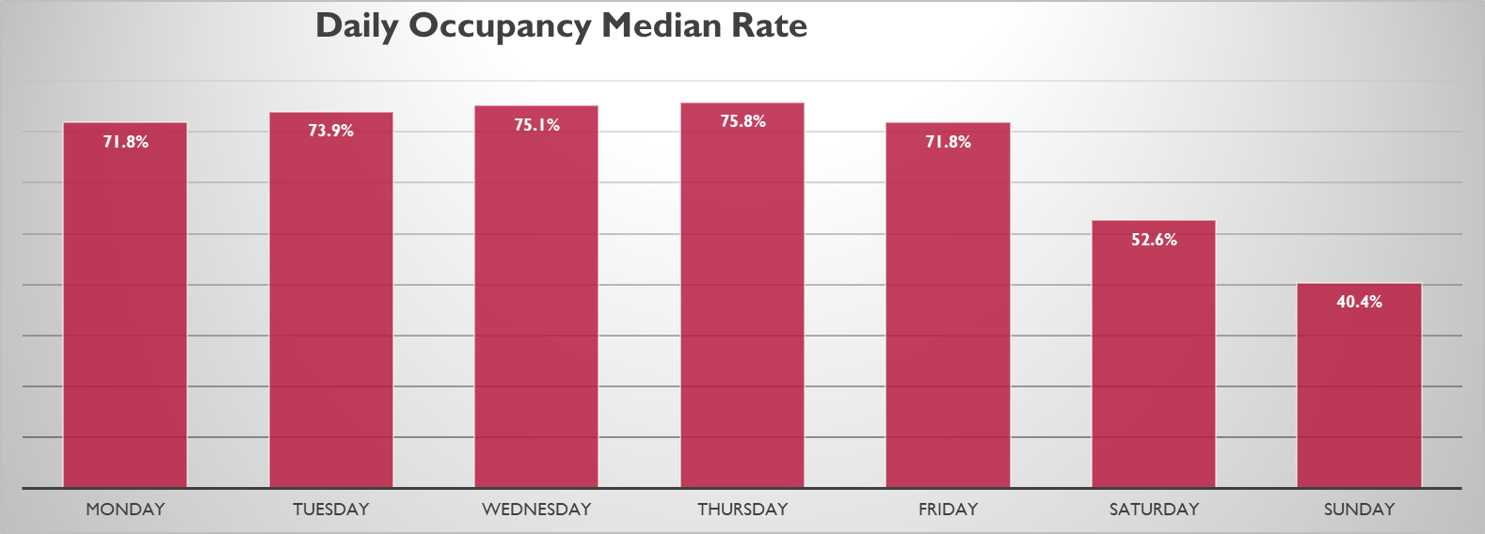
Daily Median Rates
The median occupancy rate stands at 71.8%, signifying a central tendency amidst the fluctuating rates.
Occupancy rates gradually ascend from Sunday to Thursday, peaking at 75.8% on Thursday.
However, there's a noticeable decline in occupancy over the weekend, with Saturday hitting 52.6% and Sunday dropping further to 40.4%.
Notes:
The provided graph illustrates the occupancy rates per week, with each day representing a percentage of occupancy. Upon analyzing the data, it becomes apparent that there is considerable variation throughout the week. The median occupancy rate, at 71.8%, indicates that this value serves as a central tendency amidst the fluctuations observed across different days. Notably, there is a gradual increase in occupancy rates from Sunday to Thursday, with Thursday recording the highest percentage at 75.8%. This trend suggests a peak in occupancy towards the latter half of the week, potentially influenced by factors such as business schedules or social activities. However, the pattern shifts dramatically over the weekend, with Saturday and Sunday showing significantly lower occupancy rates compared to the weekdays, marking a notable decrease in demand during weekends. Such insights into weekly occupancy trends can be invaluable for businesses and institutions in planning operations, staffing, and resource allocation effectively to accommodate fluctuating demand throughout the week.

Slide 5
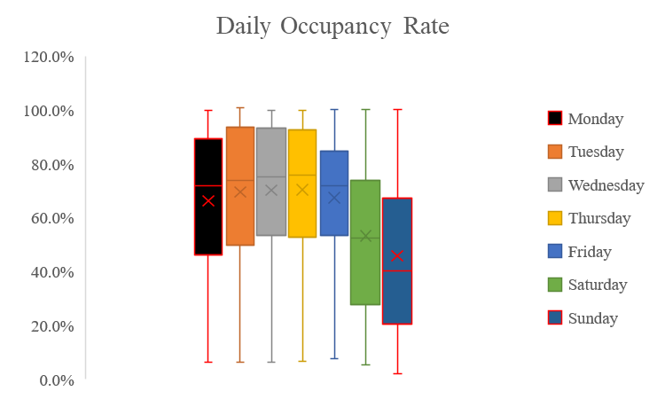
Daily Occupancy Rates
Results:
  Median occupancy rates vary throughout the week
  Highest median occupancy rates observed on Thursdays
  Lowest median occupancy rates observed on weekends
(Nagy & Simon, 2021)
Notes:
The box plots presented on this slide illustrate the occupancy rates for each day of the week. These box plots provide a visual representation of the distribution of occupancy rates throughout the week. Upon interpretation, it becomes evident that the median occupancy rate fluctuates significantly across different days.
Thursday emerges as the day with the highest median occupancy rate among the weekdays. This suggests that Thursdays typically witness a greater influx of vehicles utilizing parking facilities compared to other weekdays. Conversely, Wednesday and Tuesday exhibit lower median occupancy rates, implying relatively lesser demand for parking on these days. Notably, Saturday and Sunday stand out with the lowest median occupancy rates, indicating decreased usage of parking spaces over the weekend.
The implications drawn from these observations underscore the necessity for strategic interventions in parking management. Specifically, there is a clear need to prioritize addressing the higher demand observed on weekdays, particularly on Thursdays. Implementing targeted strategies to optimize parking availability and efficiency during peak periods can help alleviate congestion and enhance overall user experience.

Slide 6

Pie Chart: Occupancy Rates in Packing Lots
Indicates 50% of lots fall above and below this value.
Range of percentages: 32.1% to 77.5%.
Lots 02 and 03 exhibit higher percentages.
Lots 05 and 09 have the lowest percentages.
Lots 06 and 07 share the same percentage.
Insights aid in identifying performance disparities among lots.
Notes:
The provided data presents percentages associated with different lots, potentially representing metrics like occupancy or performance. Upon analysis, the median percentage emerges as 74.3%, suggesting a central tendency amidst the variability across the lots. This median value indicates that roughly 50% of the lots have percentages below 74.3%, while the other 50% have percentages above it. Notably, there is a considerable range in percentages across the lots, spanning from 32.1% to 77.5%. Lots 02 and 03 stand out with higher percentages, implying relatively better performance or higher levels of occupancy compared to others. Conversely, Lots 05 and 09 exhibit the lowest percentages, hinting at potentially poorer performance or lower occupancy rates. Interestingly, Lots 06 and 07 share the same percentage, suggesting similarity in conditions or measurements between these two lots. Overall, these insights into the distribution of percentages among the lots can inform decision-making processes, aiding in identifying areas of strength and areas that may require improvement.

Slide 7
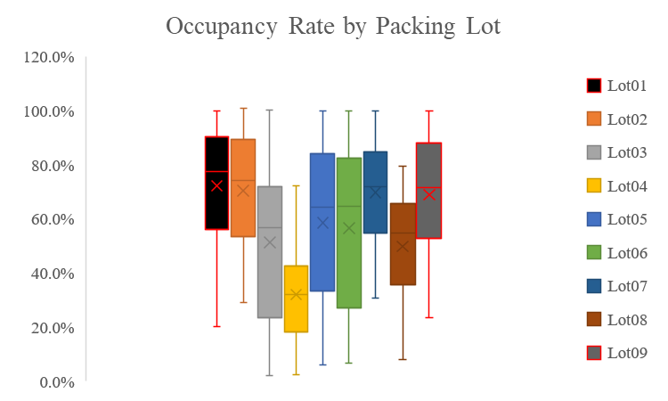
Occupancy Rates by Parking Lot
Results:
  Disparities in occupancy rates among parking lots
  Some parking lots experience higher usage compared to others
  Variations in popularity or accessibility among parking lots
(Skrodenis et al., 2021)
Notes:
This slide presents box plots that showcase the occupancy rates for each individual parking lot within the city. Through these visualizations, we discern notable variations in the occupancy levels among the various parking facilities, highlighting distinct usage patterns and demand dynamics.
The interpretation of the box plots reveals significant differences in occupancy rates across the different parking lots. Some parking lots consistently experience higher levels of occupancy compared to others, as evidenced by variations in both median occupancy rates and ranges. This suggests that certain parking lots are more frequently utilized by drivers, potentially due to factors such as location, accessibility, or amenities offered.
The implications stemming from these findings emphasize the importance of tailored approaches to parking management. Given the diverse demand patterns observed across parking lots, there arises a need for targeted interventions and strategic investments. Addressing the specific requirements of each parking facility can optimize resource allocation, improve utilization efficiency, and ultimately enhance the overall effectiveness of the parking infrastructure. Hence, policymakers and stakeholders should consider implementing strategies that cater to the unique characteristics and demands of individual parking lots to ensure optimal performance and user satisfaction.

Slide 8
Occupancy Rate With Time
Time | Lot01 | Lot05
Monday | 49.3% | 31.6%
Tuesday | 84.9% | 73.9%
Wednesday | 82.8% | 81.7%
Thursday | 83.8% | 85.7%
Friday | 84.3% | 81.3%
Saturday | 78.0% | 68.7%
Sunday | 66.0% | 30.7%
Notes:
Lot 01 Analysis:
Lot 01 exhibits relatively higher occupancy rates compared to Lot 05 across all days of the week. Throughout the weekdays, Lot 01 maintains consistent levels of occupancy, with peak rates observed from Tuesday through Friday. These peak days showcase significant demand for parking, with occupancy rates exceeding 80%. Despite slight fluctuations, Lot 01 maintains a relatively stable occupancy pattern, reflecting consistent utilization by patrons. However, on weekends, particularly Sunday, Lot 01 experiences a noticeable decrease in occupancy, dropping to 66.0%. This suggests that while Lot 01 is consistently in demand during weekdays, there is a reduced need for parking on weekends.
Lot 05 Analysis:
In contrast to Lot 01, Lot 05 demonstrates lower overall occupancy rates across the entire week. Despite experiencing peak occupancy similar to Lot 01 on weekdays, Lot 05 shows more variability in its occupancy pattern. While occupancy rates remain relatively high during weekdays, with peak rates on Thursday and Friday, Lot 05 experiences larger fluctuations in occupancy from day to day. Furthermore, on weekends, Lot 05's occupancy drops significantly, particularly on Sundays, where it reaches its lowest point at 30.7%. This suggests that Lot 05 may cater more to weekday demand or specific clientele, while facing reduced utilization during weekends. Thus, while Lot 05 experiences peak demand during weekdays, it may require different strategies to manage its weekend occupancy fluctuations effectively.

Slide 9
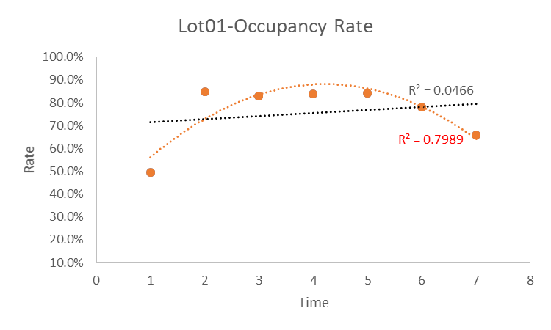
Lot01
Time-dependent variation in occupancy rates:
Non-linear
Peak occupancy observed during weekday evenings
  Potential implications for parking management strategies
(Nagy & Simon, 2021)
Notes:
The scatter plot presented here illustrates the occupancy rate against the time of day for Lot01, one of the key parking lots in our city. Through this visualization, we observe a distinct time-dependent variation in occupancy rates across different days of the week. Particularly on weekdays, such as Tuesday through Friday, we notice a significant increase in occupancy during the late afternoon and evening hours. This finding suggests that Lot01 experiences higher usage during weekdays, possibly due to commuters returning home from work or individuals visiting nearby establishments for leisure activities. Understanding these patterns is crucial for implementing effective parking management strategies, such as dynamic pricing or incentivizing alternative transportation modes during peak days. By leveraging real-time data from the smart parking space app, we can optimize the utilization of Lot01 and alleviate congestion during peak periods, ultimately enhancing the overall parking experience for motorists.

Slide 10
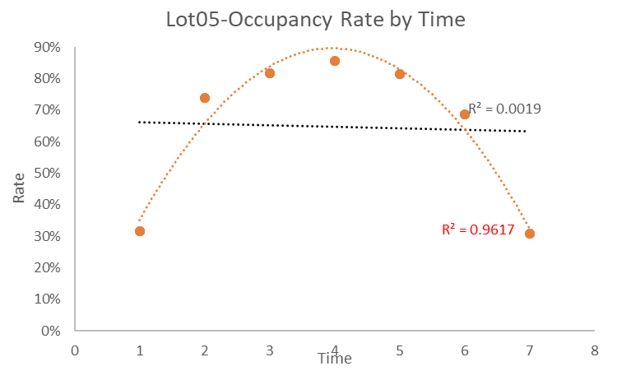
Lot05
Results:
  Similar time-dependent variation in occupancy rates as observed in Lot01
  Consistent patterns of peak occupancy during weekday evenings
  Implications for parking demand and utilization
(Skrodenis et al., 2021)
Notes:
The scatter plot showcased on this slide depicts the relationship between the occupancy rate and the time of day for Lot05, another prominent parking facility in our city. Similar to Lot01, we observe a notable time-dependent variation in occupancy rates across different days of the week. Peak occupancy is evident during weekdays, particularly from Tuesday to Friday, indicating heightened parking demand during these days. This pattern aligns with typical urban dynamics, where individuals engage in activities such as dining out, attending events, or running errands after work hours. By recognizing these trends, we can tailor parking management strategies for Lot05, such as optimizing staffing levels or implementing dynamic pricing to incentivize off-peak usage. Moreover, leveraging insights from the smart parking space app can facilitate proactive decision-making and improve the overall efficiency of parking operations for Lot05, contributing to enhanced urban mobility and customer satisfaction.

Slide 11
Recommendations
Implement the smart parking space app based on analysis and evaluation.
Emphasize positive impacts on:
  Traffic congestion,
  Quality of life, and
  Urban mobility.
Highlight alignment with city's sustainable development goals and vision.
Notes:
Upon thorough analysis of the parking data, it is evident that the city stands to benefit significantly from the adoption of a data-driven parking space management system. The insights derived from the examination of both box plots and scatter plots provide invaluable guidance for the design and implementation of such a system, which holds immense promise in effectively addressing the multifaceted parking challenges faced by the city. The detailed visualization of occupancy rates across different days of the week and parking lots offers a nuanced understanding of the underlying demand patterns and usage dynamics. Leveraging these insights can inform the development of a tailored system that not only optimizes parking resource allocation but also enhances user experience and mitigates congestion. By integrating real-time parking availability information and employing data-driven decision-making processes, the proposed system can revolutionize urban mobility, offering a seamless and efficient parking experience for residents and visitors alike. Therefore, it is strongly recommended that the city proceeds expeditiously with the implementation of this transformative solution to unlock its myriad benefits and usher in a new era of sustainable and effective parking management.

Slide 12
Key Benefit
Improved Traffic Flow and Reduced Congestion
Enhanced User Experience
Optimization of Parking Resources
Notes:
The proposed data-driven parking space management system promises several key benefits that can significantly enhance the urban mobility landscape:
Improved Traffic Flow and Reduced Congestion: By leveraging real-time parking availability information, the system can facilitate more efficient traffic management. Motorists will be able to access up-to-date information regarding parking space availability, enabling them to make informed decisions about their route and parking options. Consequently, this can lead to reduced congestion on roadways and improved traffic flow throughout the city.
Enhanced User Experience: One of the primary advantages of the proposed system is its ability to enhance the overall user experience for motorists. Searching for parking spaces often entails frustration and time-consuming efforts. However, by providing accurate and accessible information about available parking spots, the system can streamline the parking process, minimizing the time and effort required for drivers to locate suitable parking facilities. This, in turn, contributes to a more positive and efficient experience for users.
Optimization of Parking Resources: A data-driven approach allows for the optimization of parking resources based on real-time demand patterns and usage trends. By analyzing historical data and monitoring current parking trends, the system can identify areas of high demand and allocate resources accordingly. This optimization ensures that parking facilities are utilized efficiently, maximizing their capacity while minimizing instances of overcrowding or underutilization. Moreover, data-driven decision-making enables city authorities to implement targeted strategies to address specific demand patterns and optimize the overall utilization of parking resources.

Slide 13
references
Nagy, A. M., & Simon, V. (2021). Improving traffic prediction using congestion propagation patterns in smart cities. Advanced Engineering Informatics, 50, 101343. https://doi.org/10.1016/j.aei.2021.101343
Skrodenis, D., Čygas, D., Pakalnis, A., & Kairys, A. (2021). Traffic Management Solutions at Roadwork Zones During Planned Special Events. The Baltic Journal of Road and Bridge Engineering, 16(2), Article 2. https://doi.org/10.7250/bjrbe.2021-16.522

